Slide 1
FedMultiMed: A Federated Multi-Modal Ensemble Framework for Medical Image Classification with Explainable AI
M M Tasnim Bin Hannan
ID : 0242220005101062
And
Joy Mojumder
ID : 0242220005101132
Department of CSE
Daffodil International University

Slide 2
Outline
Introduction
Objective
Background Study
Gap Analysis
Methodology
Sample Dataset
Results & Analysis
Novelty of the Work
Conclusion
References

Slide 3
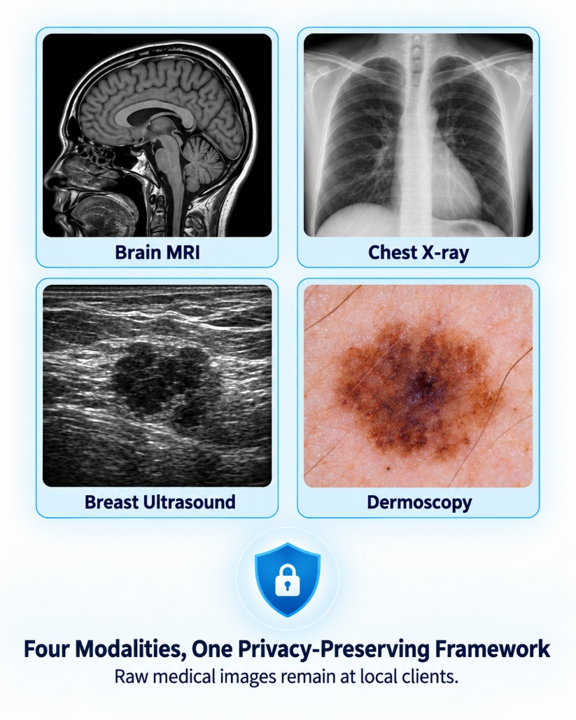
Introduction
Medical imaging plays an important role in early disease diagnosis and modern healthcare. Deep learning has achieved strong results in medical image classification, but many existing systems focus on only one imaging modality and often depend on centralized data storage, which can create privacy and data-sharing concerns. Different medical images, such as brain MRI, chest X-ray, breast ultrasound, and dermoscopy, also have different visual characteristics and class distributions. To address these challenges, FedMultiMed combines federated learning, ensemble model, and Explainable AI in a single multi-modal medical image classification framework.

Slide 4
Objective
OBJECTIVE 1 — Multimodal Evaluation & Complementary Backbone Selection
To evaluate pretrained CNN models and select optimal backbones for multimodal medical image classification across brain MRI, chest X-ray, breast-ultrasound, and dermoscopic images.
OBJECTIVE 2 — Privacy-Preserving Federated Ensembling Framework
To develop a privacy-preserving federated learning framework using the selected CNN backbones that evaluates multiple aggregation methods and builds a calibrated hybrid ensemble without transferring raw patient data.
OBJECTIVE 3 — Diagnostic Validation & Quantitative Explainable AI
To evaluate the diagnostic performance through held-out testing and cross-validation, and analyze prediction decisions using Grad-CAM, Grad-CAM++, Integrated Gradients, and LIME.

Slide 5
Background Study
Author(s) | Year | Title | Methodology | Key Findings
Haripriya et al. [1] | 2025 | Privacy-Preserving Federated Learning for Collaborative Medical Data Mining | EfficientNetV2 and ResNet-RS were trained using adaptive FedAvg and FedSGD based on client-data divergence. | Achieved up to 96.3% accuracy, but used fixed clients and communication rounds.
Muntaqim and Smrity [2] | 2025 | Federated Learning Framework for Brain Tumor Detection Using MRI Images | VGG19 was trained across four non-IID clients using FedAvg, FedProx, and SCAFFOLD with Grad-CAM. | SCAFFOLD achieved 98.45% accuracy, but the study covered only brain MRI with simulated clients.
Borazjani et al. [3] | 2025 | Multi-Modal Federated Learning for Cancer Staging Over Non-IID Datasets | Distributed gradient blending and proximity-aware weighting combined histopathology, clinical, and molecular data. | Improved accuracy by about 10–15 percentage points, but validation was limited to TCGA cohorts.
Fan et al. [4] | 2025 | A Personalized Multimodal Federated Learning Framework for Skin Cancer Diagnosis | Hierarchical aggregation, modality imputation, and attention-based fusion were used for incomplete multimodal data. | Achieved 92.32% accuracy and reduced communication by 32.9%, but focused only on skin cancer.
Gupta et al. [5] | 2025 | Applying YOLOv6 as an Ensemble Federated Learning Framework | Pruned YOLOv6 models were trained across five clients with ensemble prediction and homomorphic encryption. | Achieved 98% and 97% validation accuracy, but covered only breast-related datasets.
Pervez et al. [6] | 2025 | Towards Trustworthy AI-Driven Leukemia Diagnosis | EfficientNetB3 was trained through hierarchical federated learning and evaluated with 18 XAI methods. | Quantitatively evaluated explanation quality, but considered only microscopic blood-cell images.

Slide 6
Gap Analysis
Study | Multi-modal | Federated | Ensemble | XAI | Aggregation Compared | Leakage-Controlled
Haripriya et al. [1] | Yes | Yes | No | No | Yes | No
Muntaqim & Smrity [2] | No | Yes | No | Yes | Yes | No
Borazjani et al. [3] | Yes | Yes | No | No | No | No
Fan et al. [4] | Yes | Yes | No | No | Yes | No
Gupta et al. [5] | Yes | Yes | Yes | No | No | No
Pervez et al. [6] | No | Yes | No | Yes | No | No
Proposed FedMultiMed | Yes | Yes | Yes | Yes | Yes | Yes
KEY TAKEAWAY FROM GAP ANALYSIS:
The reviewed studies address individual areas such as multimodality, federated Learning, ensemble models, or explainable AI. However, none of them combines all these features together in a single framework. FedMultiMed addresses this integration gap within one framework.

Slide 7
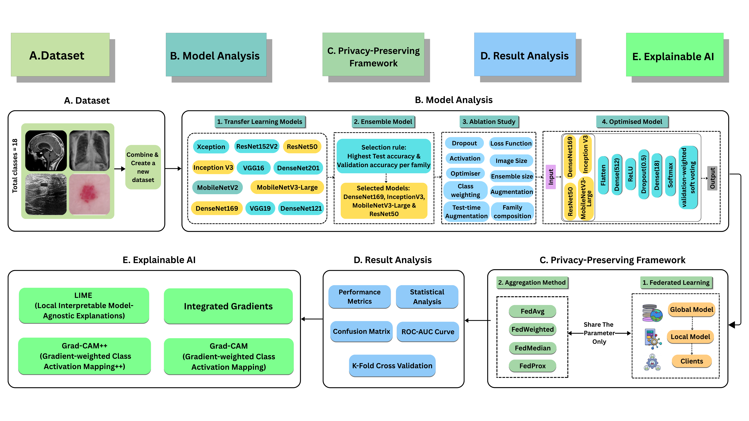
Methodology

Slide 8
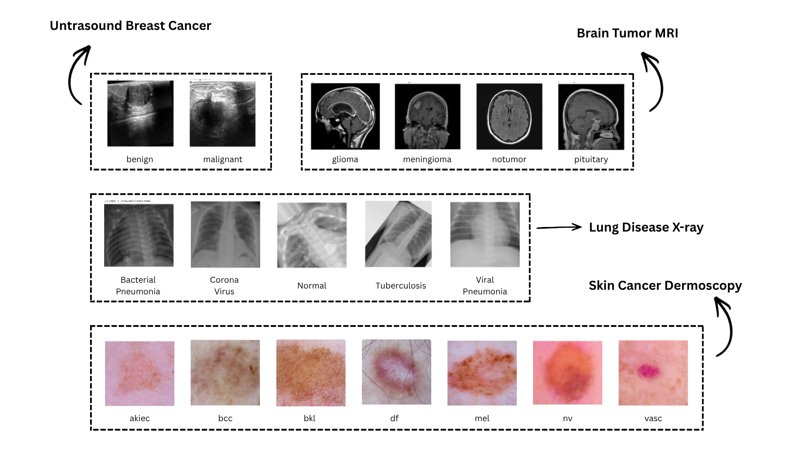
Sample dataset
Modality | Classes | Images
Brain MRI | 4 | 7,200
Chest X-ray | 5 | 10,095
Breast Ultrasound | 2 | 9,016
Dermoscopy | 7 | 10,015
Total | 18 | 36,326
36,326 images across 4 modalities

Slide 9
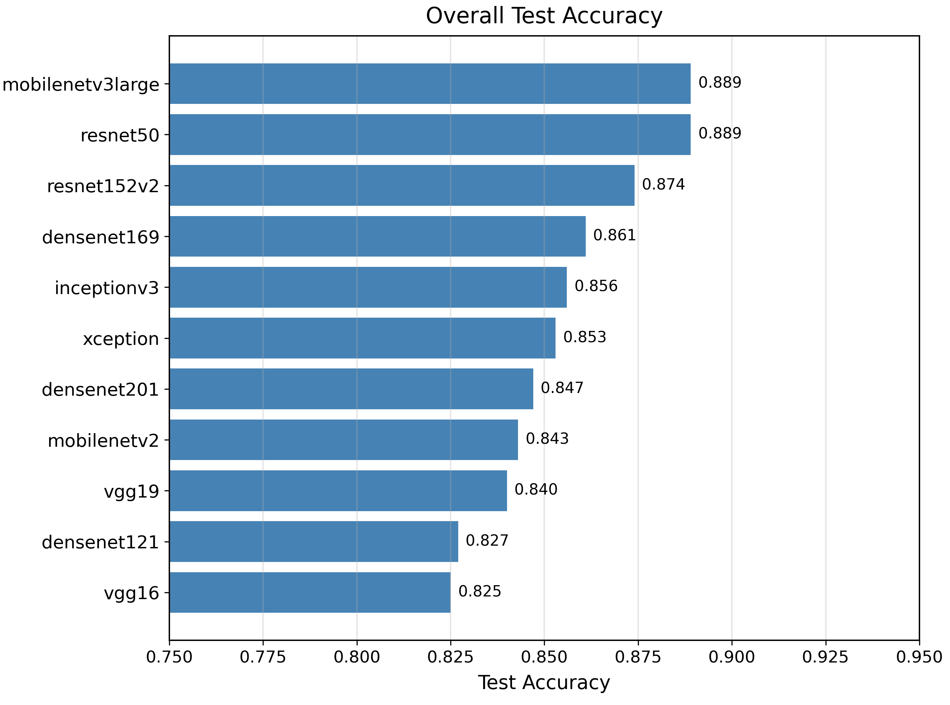
Result and Analysis
Candidate Backbone Benchmark (11 Models)
Class Weighting and Loss-Function Ablation
Configuration | Accuracy | Macro-F1 | Dermoscopy
Square-root balanced weighting | 0.9127 | 0.8100 | 0.8123
Label smoothing | 0.9068 | 0.8310 | 0.7903
No weighting | 0.9017 | 0.7620 | 0.7903
Balanced weighting | 0.8941 | 0.8227 | 0.7523
Focal loss | 0.4722 | 0.1694 | 0.6697
Kullback–Leibler divergence | 0.4711 | 0.1766 | 0.6692
• Square-Root Weighting Selected: Achieved top accuracy (0.9127) and top dermoscopy performance (0.8123), balancing severe lesion imbalance.
• Catastrophic Loss Collapse: Focal loss and KL divergence completely collapsed on the 18-class corpus (accuracy dropped to ~0.47; MRI collapsed to 0.25 chance).
• F1 vs. Accuracy Trade-Off: Label smoothing yielded higher macro-F1 (0.8310) but reduced overall accuracy and dermoscopy (0.7903), favoring square-root weighting.

Slide 10
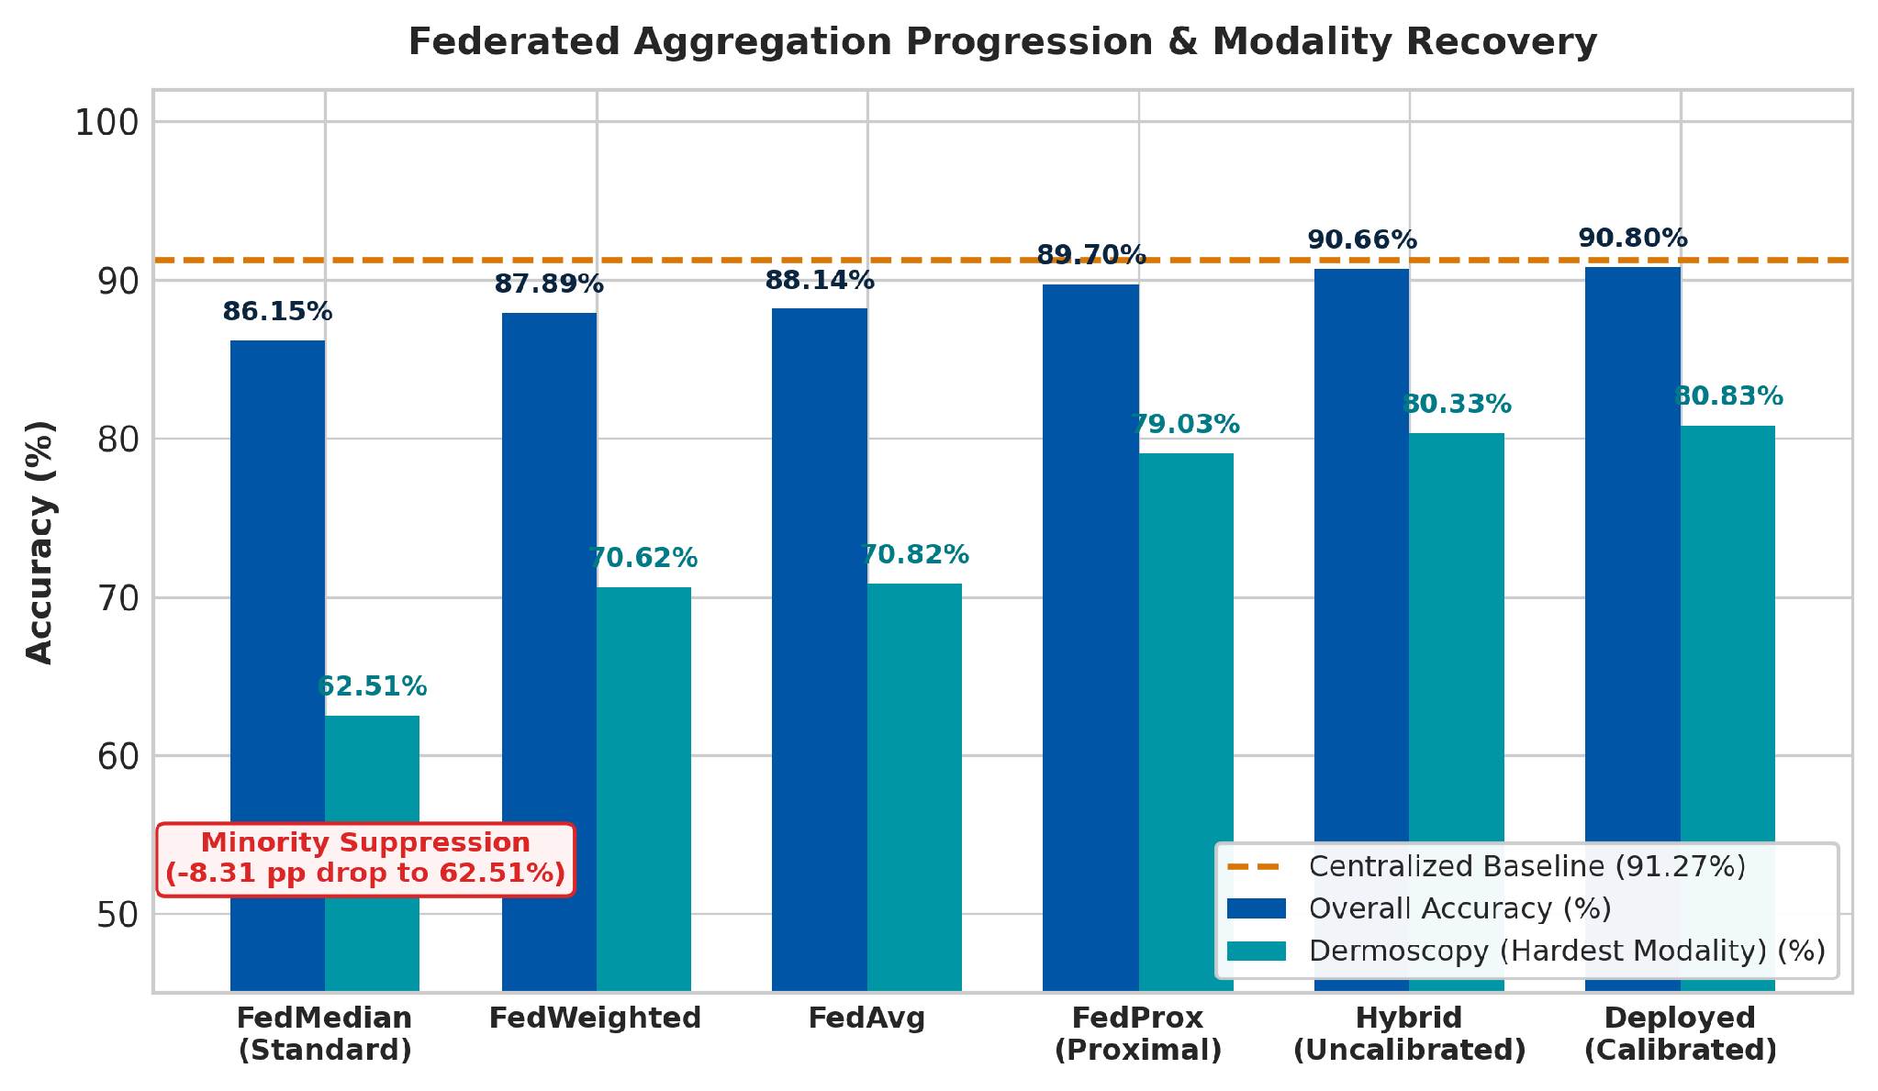
Result and Analysis
Aggregation Strategies vs. Centralized Baseline (91.27%)
Strategy | Overall Acc | Dermoscopy | vs Centralized
Centralized Baseline | 91.27% | 81.23% | 0.00 pp
FedMedian | 86.15% | 62.51% | −5.12 pp (Failed on skin)
FedWeighted | 87.89% | 70.62% | −3.38 pp
FedAvg | 88.14% | 70.82% | −3.13 pp
FedProx | 89.70% | 79.03% | −1.57 pp
Hybrid (Uncalibrated) | 90.66% | 80.33% | −0.61 pp
Hybrid (Deployed Calibrated) | 90.80% | 80.83% | −0.47 pp (Final Model)
CORE RESEARCH DISCOVERY & PRIVACY-PERFORMANCE BALANCE:
Standard FedMedian severely penalizes minority skin cancer (-8.31 pp drop to 62.51%). Our proposed Hybrid FedProx + Temperature Calibration successfully recovers Dermoscopy to 80.83% and delivers 90.80% overall accuracy, maintaining raw-data privacy with only a 0.61 pp federation cost against the 91.27% centralized baseline.

Slide 11
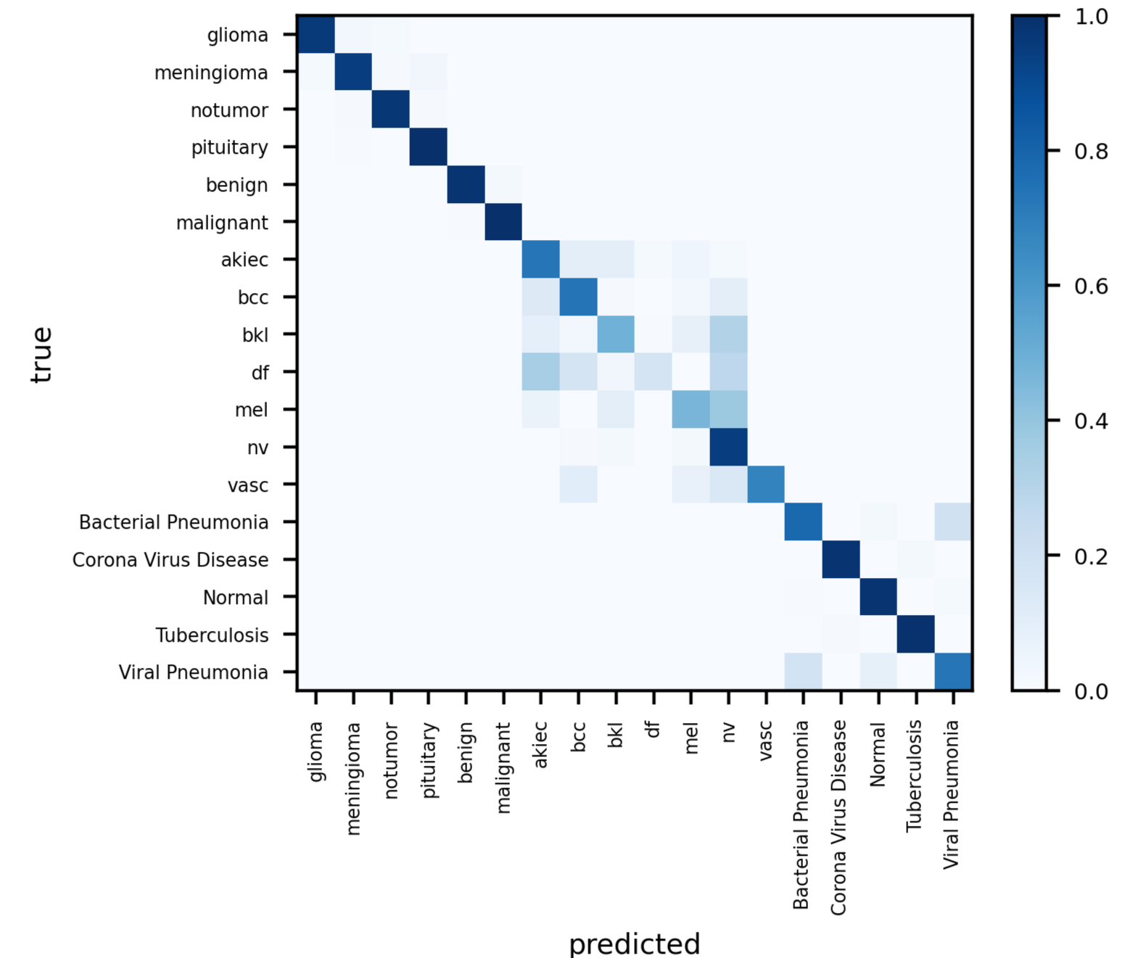
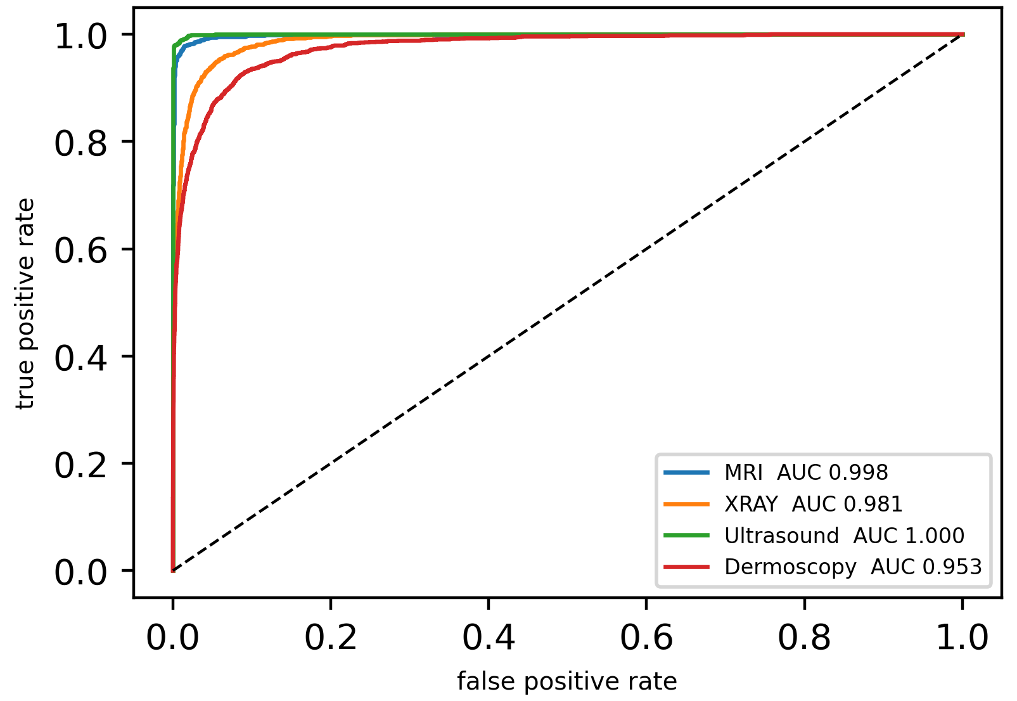
Result and Analysis
18-Class Confusion Matrix (n = 7,261)
One-vs-Rest (OvR) ROC Curves by Modality
• Near-Zero Cross-Modality Error: Only 1 of 7,261 test predictions crossed modalities (0.014% error rate).
• High Diagnostic Discrimination: Overall Macro-AUC of 0.9940 (Ultrasound 1.000, MRI 0.998, CXR 0.981, Dermoscopy 0.953).
• Clinically Confined Errors: Residual misclassifications strictly occurred within adjacent disease subtypes.

Slide 12
Result and Analysis
90.80%
TEST ACCURACY
[90.13%, 91.43%] 95% CI
0.8136
MACRO-F1 SCORE
Balanced across 18 classes
0.9940
MACRO-AUC (OvR)
Class discrimination
91.02%
5-FOLD CV ACCURACY
± 0.52% across partitions
Performance Breakdown by Modality (7,261 Test Images)

Slide 13
Novelty of the Work
Federated Multi-Modal Learning Framework
FedMultiMed combines brain MRI, chest X-ray, breast ultrasound, and dermoscopy within one 18-class federated learning framework using modality-partitioned non-IID clients.
Privacy-Conscious and Leakage-Controlled Design
Raw training images remain within their local clients, while only model parameters are shared. Lesion-grouped partitioning also prevents HAM10000 samples from leaking across data splits.
Architecture-Aware Hybrid Ensemble
Four aggregation methods are evaluated across different CNN backbones. The strongest strategy for each backbone is used to construct a calibrated soft-voting ensemble.
Quantitatively Evaluated Explainability
Grad-CAM, Grad-CAM++, Integrated Gradients, and LIME are evaluated through faithfulness, localisation, and sensitivity analysis, providing evidence beyond visual heatmaps.

Slide 14

Conclusion
FedMultiMed demonstrates that federated learning, complementary CNN backbones, and explainable AI can be integrated into one multi-modal medical-image classification framework without transferring raw training images. The calibrated hybrid ensemble achieved 90.80% accuracy, 0.8136 macro F1, and 0.9940 macro AUC on 7,261 held-out images, while five-fold subject-grouped validation reached 91.02 ± 0.52% accuracy. The results are strong across MRI, X-ray, and ultrasound, although minority dermoscopy classes remain difficult. Therefore, the framework is suitable as a research decision-support system, but further external clinical validation and stronger privacy mechanisms are needed before real-world deployment.

Slide 15
References
[1] R. Haripriya, N. Khare, and M. Pandey, “Privacy-preserving federated learning for collaborative medical data mining in multi-institutional settings,” Scientific Reports, vol. 15, no. 1, Apr. 2025, doi: 10.1038/s41598-025-97565-4.
[2] M. Z. Muntaqim and T. A. Smrity, “Federated Learning Framework for Brain Tumor Detection Using MRI Images in Non-IID Data Distributions,” Journal of Imaging Informatics in Medicine, vol. 38, no. 6, pp. 3909–3927, 2025, doi: 10.1007/s10278-025-01484-9.
[3] K. Borazjani, N. Khosravan, L. Ying, and S. Hosseinalipour, “Multi-Modal Federated Learning for Cancer Staging Over Non-IID Datasets With Unbalanced Modalities,” IEEE Transactions on Medical Imaging, vol. 44, no. 1, pp. 556–573, Jan. 2025, doi: 10.1109/tmi.2024.3450855.
[4] S. Fan, A. Ahmed, X. Zeng, R. Xi, and M. Hou, “A Personalized Multimodal Federated Learning Framework for Skin Cancer Diagnosis,” Electronics, vol. 14, no. 14, pp. 2880–2880, July 2025, doi: 10.3390/electronics14142880.
[5] C. Gupta, N. S. Gill, P. Gulia, N. Alduaiji, J. Shreyas, and P. K. Shukla, “Applying YOLOv6 as an ensemble federated learning framework to classify breast cancer pathology images,” Scientific Reports, vol. 15, no. 1, Jan. 2025, doi: 10.1038/s41598-024-80187-7.
[6] K. Pervez, S. I. Sohail, F. Parwez, and M. A. Zia, “Towards trustworthy AI-driven leukemia diagnosis: A hybrid Hierarchical Federated Learning and explainable AI framework,” Informatics in Medicine Unlocked, p. 101618, Jan. 2025, doi: 10.1016/j.imu.2025.101618.

Slide 16
THANK YOU

